Slide 1
Department of Computer Science & Engineering
UE17CS355 – Web Tech II Laboratory
Project Evaluation
Project Title : Airline Ticket Reservation Service
Project Team : PES1201700830 – Dheeraj Reddy
PES1201700689 - Roshan Jinesh

Slide 2
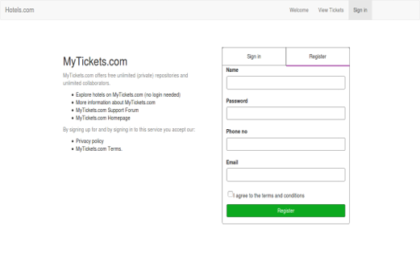
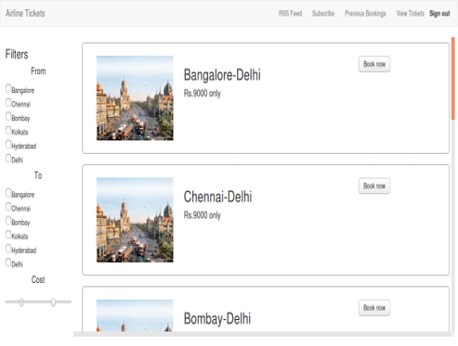
Project Description
This application can be used to book tickets with an airline of the user’s choice, based on prices and availability of tickets.

Slide 3
Technologies Used
CSS, Javascript and PHP
Database - SQLite3
Flask Framework

Slide 4
Techniques Implemented
RSS Feeds
Submission Throttling
Multistage Download
Predictive Fetch

Slide 5
Intelligent Functionality
The application can calculate the discount that the user will receive as well as stay updated with dynamic prices and availability of tickets.

Slide 6
Thank You

